Slide 1
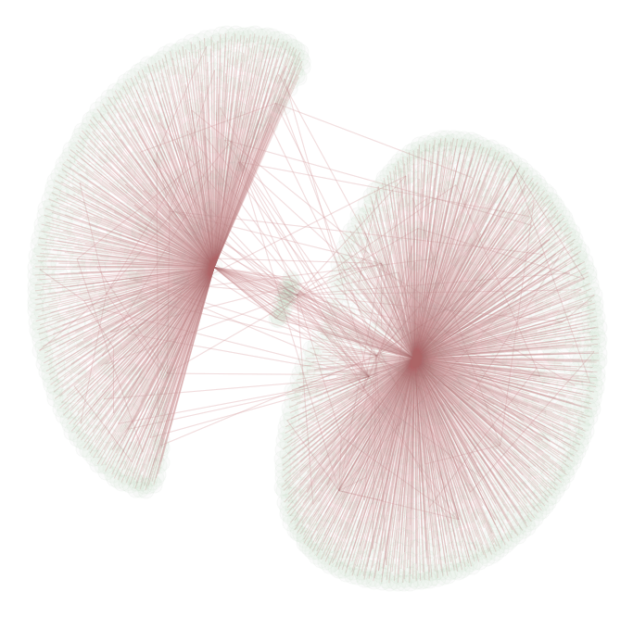

Network Analysis of with Crunchbase
Project Team
Aditya Mengani
Ognjen Sosa
Sanjay Elangovan Song Park
Sophia Skowronski
Notes:
Merry christmas!

Slide 2
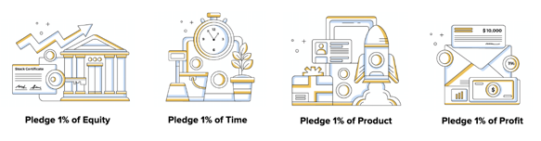
From last time….
Movement of corporate philanthropy, via a membership model
More than 12,000 companies in over 100 countries committed to giving back
Membership requirements: CEO/Senior Exec sign-off & website
Pledge types
1% of equity
1% of staff time
1% of product
1% of company profit

Slide 3
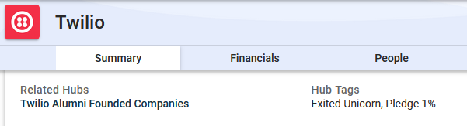
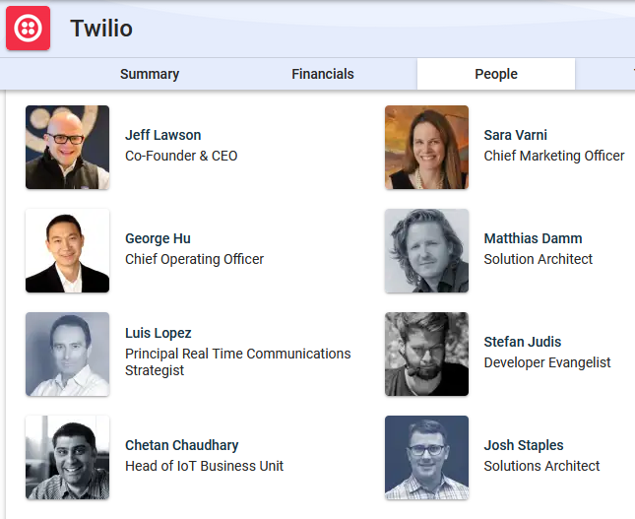

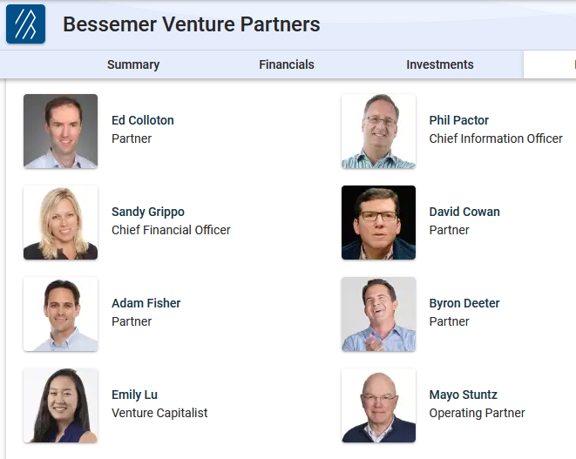

From last time….
Dataset
+1M organizations
Company information, leadership, investments and funding, etc.
Pledge 1% companies are tagged in Crunchbase

Slide 4
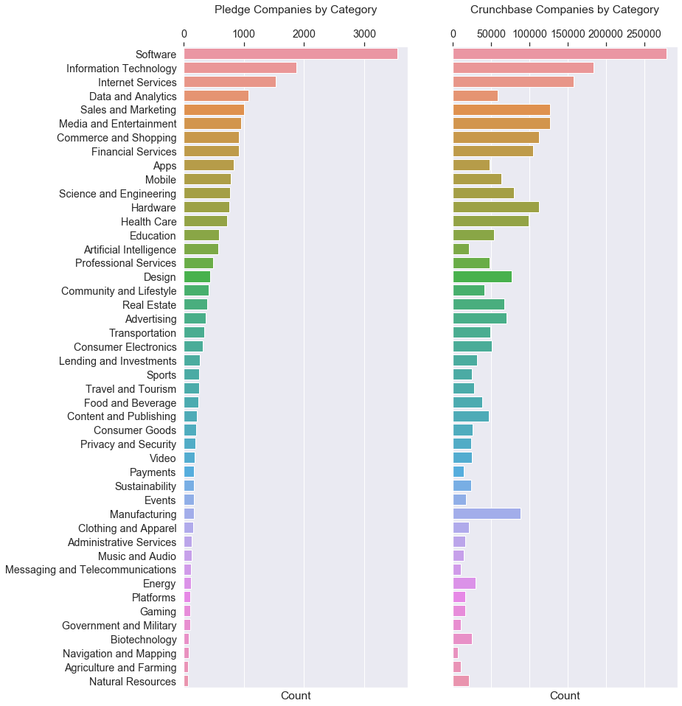
From last time….
What we found: Pledge 1% has a unique footprint in Crunchbase
Industry
Country
Age
Total funding
Rank
Baseline scores: LRR -- 0.50 | BNB -- 0.68 | KNN -- 0.62
Focus of our project: leverage network information to improve our baseline

Slide 5

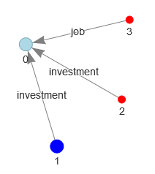
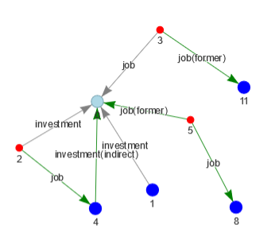
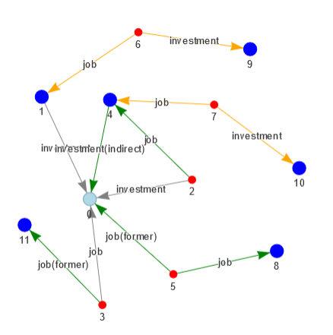
Creating the graph
Decisions
Representing the relationships and their significance
Reducing overall size of Crunchbase for sampling → 4 or 5 degrees away
Graph features on sampled network → 3 degrees away

Slide 6
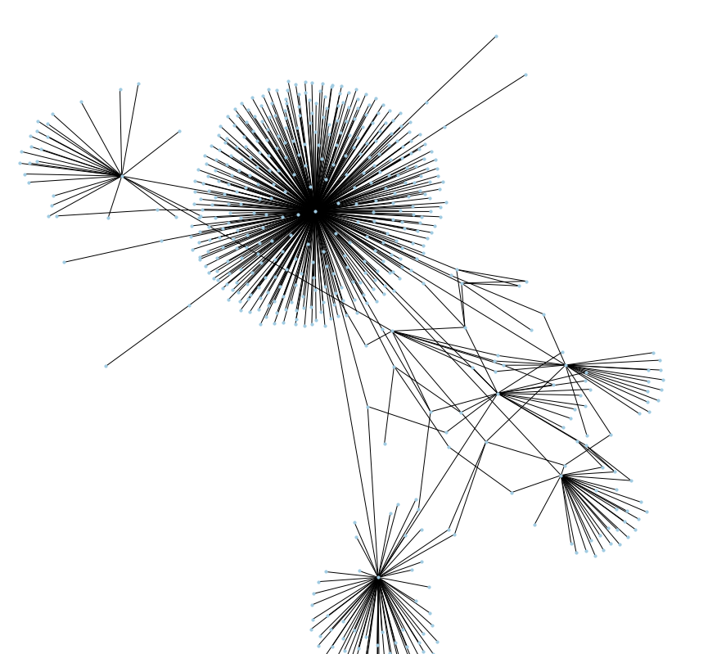
Primary relationships
VC firm investing in a company
Partner at VC Firm investing in a company
Person has current job at a company

Slide 7
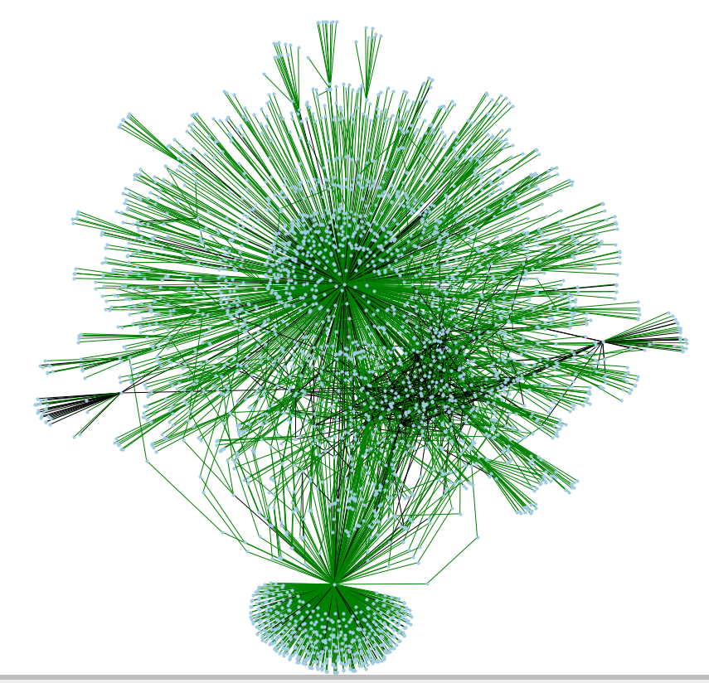
Secondary relationships
What's added in green
Former jobs of current employees
Former employees and their new jobs
Partner investors' affiliation with their VC firm and the indirect link to the same invested company

Slide 8
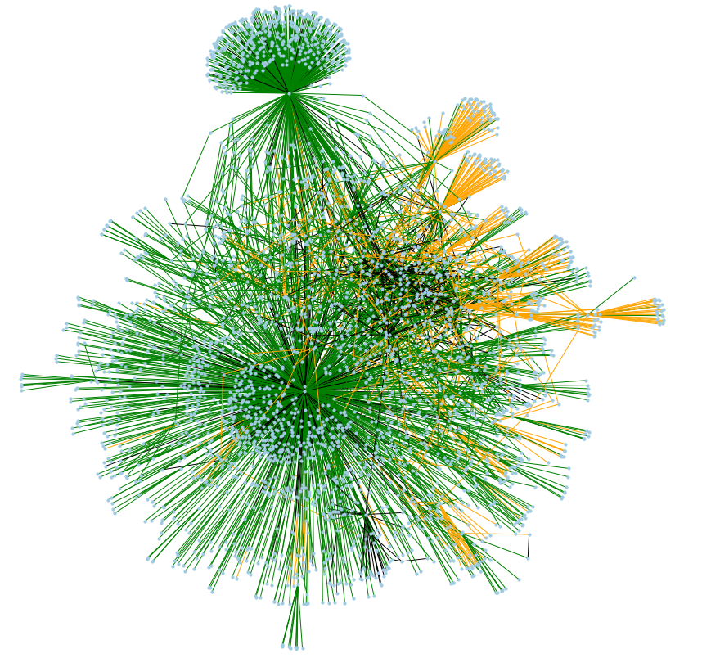
Tertiary relationships
What’s added in orange
Coworkers of partner investors and their current investments

Slide 9
Overall graph features
Size
Crunchbase G(Vertices: 1,290,346 | Edges: 2,085,199)
Pledge 1% G (Vertices: 61,100 | Edges: 121,156)
Model G (Vertices: 385,037 | Edges: 732,803)
Density = 2*E / V*(V-1) -- Very sparse networks
Crunchbase 0.00000250475
Pledge 1% 0.0000649082
Model 0.00000988583

Slide 10
Graph pipeline processing for modeling
50 individual graphs from 2 neighborhood sizes = 100 graphs total
4 degrees away from Pledge 1% companies
5 degrees away from Pledge 1% companies
100 x 10-15 minutes processing step
Sample organizations from one of the two lists
Reduce Crunchbase graph to 3 degrees around sample
~12K records each (half/half +/-)
Calculate graph features
Pagerank, weighted pagerank, shortest path, weighted shortest paths, in degree/out degrees, k-core decomposition

Slide 11

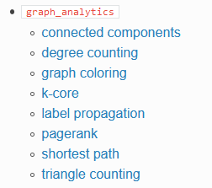
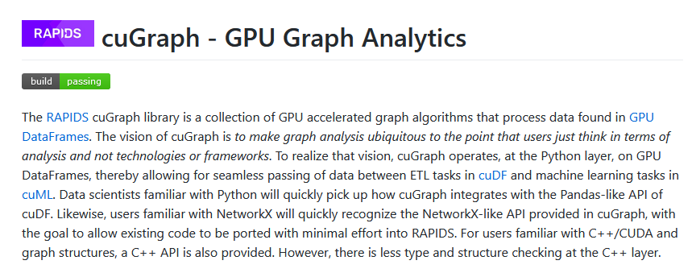

Our graph analytics struggle session
turicreate saved the day
Otherwise, needed GPU support
Many NetworkX methods inaccessible due to timing constraints
cuGraph: GPU accelerated graph algorithms

Slide 12
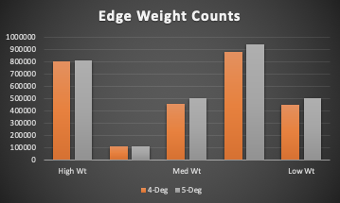
Calculating Graph Features: Applying weights
Network relationships can be influenced by number of factors of varying strength
Graph edges, representative of links, can be weighted differently based on observed/perceived ‘real-world’ connectivity
Our Methodology: Based on baseline EDA and intuition, edge weights assigned based on importance (primary = 3, secondary = 2, tertiary = 1) and job/investment affiliation (job = 1, investment = 2)
Notes:
Not all relationships in a network are equal. For example, the link between two people, that are connected through a family relationship might be stronger than a link between two business associates.
These links can be weighted so that they represent real-world strengths in social network analysis. Weighting key paths in the network might also infer that the entities by using them to channel information have key roles to play. For this reason, centrality measure results are affected by link weightings.
Primary relationships
VC Firm investing in a company
Partner at VC Firm investing in a company
Person has current job at a company
Secondary relationships
What's added in green:
Former jobs of current employees of companies
Former employees of companies and their new jobs
Partner investors' affiliation with their VC firm and the indirect link to the same invested company
Teritiary relationships
What's added in orange:
Coworkers of partner investors and their current investments

Slide 13
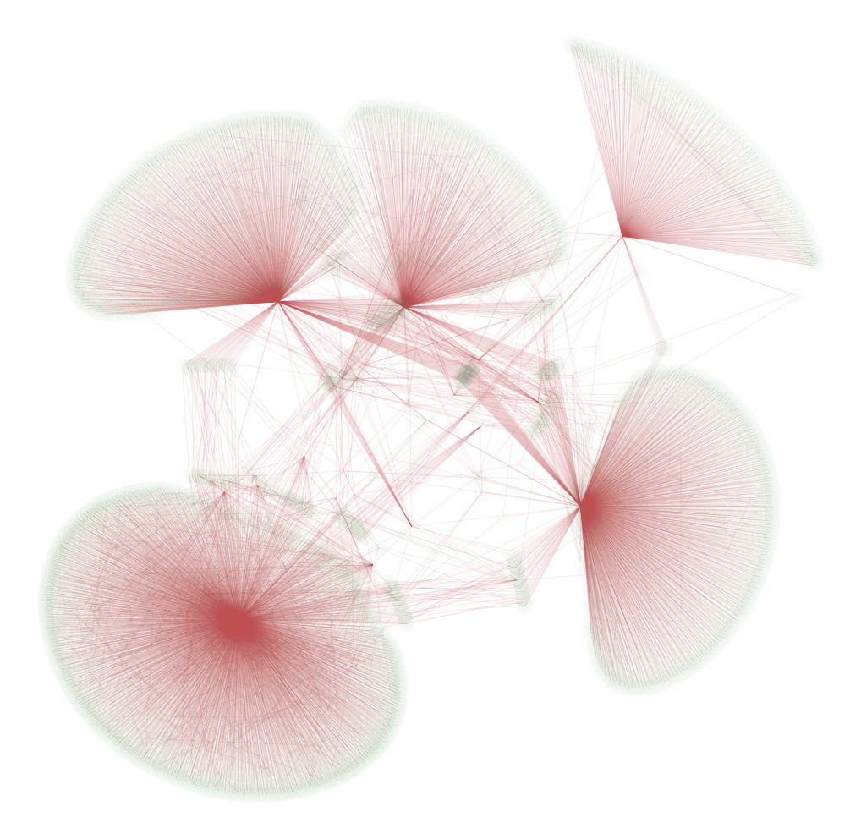
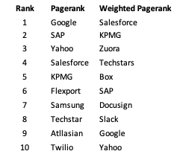
Graph Features & EDA: Pagerank, weighted vs. not
Weighted edges represent real-world strengths of relationships
Notes:
As we covered in class …
Definition: PageRank is a variant of EigenCentrality, also assigning nodes a score based on their connections, and their connections’ connections. The difference is that PageRank also takes link direction and weight into account – so links can only pass influence in one direction, and pass different amounts of influence.
What it tells us: This measure uncovers nodes whose influence extends beyond their direct connections into the wider network.
When to use it: Because it takes into account direction and connection weight, PageRank can be helpful for understanding citations and authority.
Weighted Pagerank vs Pagerank
Weighted PageRank algorithm is an extension of the conventional PageRank algorithm based on the same concept.
Weighted PageRank algorithm assigns higher rank values to more popular (important) pages instead of dividing the rank value of a page evenly among its outlink pages. Each outlink page gets a value proportional to its popularity, i.e. its number of inlinks and outlinks.

Slide 14
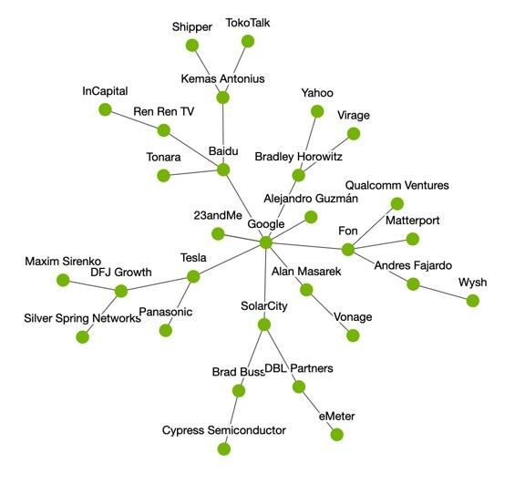
Graph Features & EDA: Shortest path
The shortest distance from a vertex on the graph to all other points on the graph
How closely connected are investors and people to Pledge 1% companies?
Weights based on type of relationship
Turicreate calculates shortest path without directions
Shortest path: 3
Shortest path: 2
Notes:
One of the easier to understand features that we worked on was the “shortest path”. This feature simply measures the undirected shortest possible path between a vertice to another. To the right is a subsection of the graph around Google, with a couple of the unweighted shortest paths indicated. We initially tried calculating the shortest distance from each company to each of the P1% companies, but this was very computationally intensive. It took nearly 60 hours for my computer to finish the feature calculation for just one graph. In order to make this feasible for all the graphs we wanted to test, we decided to look at the distance from the top 5 Pageranked P1% companies to the remaining companies in the database, as well as the minimum distance from each company to any of the top 5 companies. By using these major companies as proxies, we thought we could figure out how well connected investors are to P1% companies.
Another complication we added to this feature was weights. Using the weights that Oggie worked on, we were able to assign values based on the type of relationship between the companies. This produced another 6 features - 1 for each of the top 5 p1% companies, and the minimum distance.

Slide 15
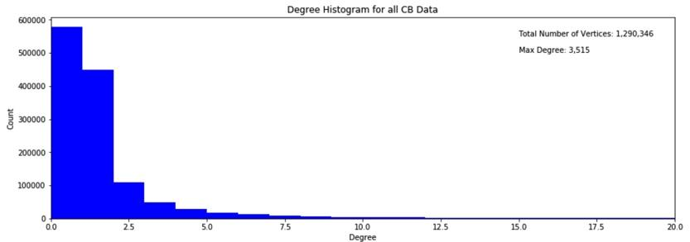
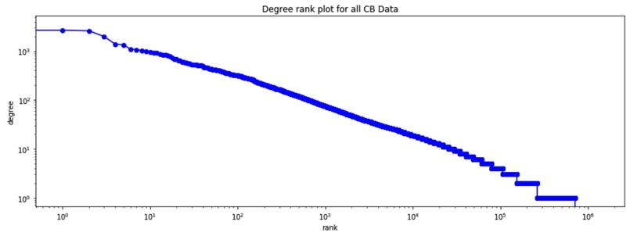
Graph Features & EDA: Degrees
Degree is a measure of how many other nodes each vertex is connected to. Many vertices in this graph aren’t well connected. Rank is calculated as the number of vertices minus the number of connected components.
Notes:
Another feature we looked at was degree count. This is just a measure of how many other nodes each vertex is connected to. There are three total measures we could have used: In-Degree, Out-Degree, and Total Degree. In our model, we only ended up using In and Out degree, since Total degree is just the sum of In and Out Degree.
When conducting EDA on the whole database, we found that the data is quite sparse, as shown in the histogram on the top. This histogram shows that a large majority of the values in the CB database have fewer than 2 degrees of connection.
Another chart that we made while looking at the degree measures was the rank and degree chart. The rank is a measure of how connected a vertex is - It’s the difference between the number of values in a given vertice’s adjacency matrix and the number of connected components. As you can see, as the rank gets small the degree is very high - This means that the vertex is well connected since the number of connected components is equal to the number of values in the adjacency matrix.

Slide 16
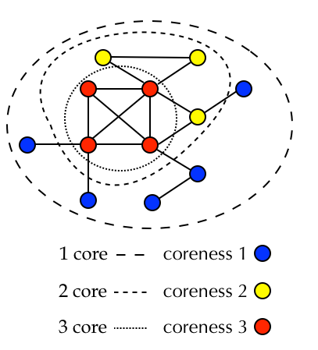
Graph Features & EDA: k-Core decomposition
K-Core looks at how many other vertices each vertex is connected to.
Measure of connectedness within the graph.
Are companies/people in higher K-Cores also more likely to invest?
Notes:
Another graph feature we looked at was K-Core Decomposition. Similar to degree, this looks at how many nodes each vertice is connected to. The algorithm recursively removes vertices from the graph with degree less than k. The value of k where a vertex is removed is its core ID.
This is a measure of community detection, with the idea being that this feature identifies vertices in better connected groups, who may end up being more likely to donate.
Now that we’ve covered the graph features, we’ll start talking about the feature engineering we did to use these values.

Slide 17
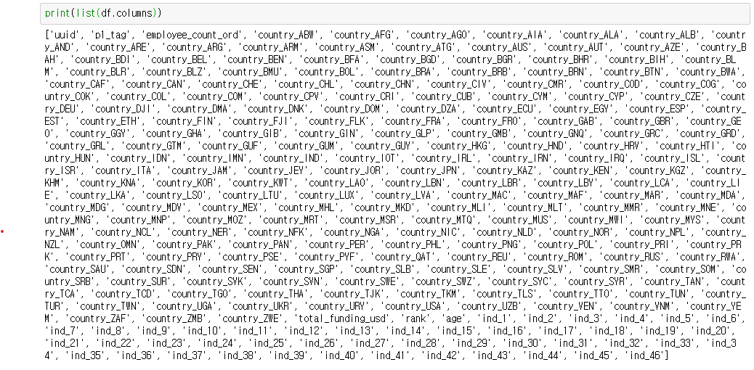
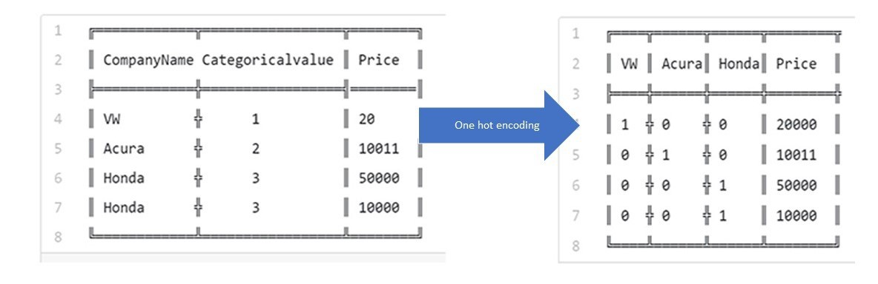
Feature Engineering: One Hot Encoding
One hot encoding of industry & country(Best)
Turning categorical variables into binary vectors
Positive: no order/hierarchy/weighting issues
Negative: adds a lot more columns!

Slide 18

Feature Engineering (cont’d)
Ordinal scaling for employee_count
1-10: 1
11-50: 2
51-100: 3
etc
Linear regression imputation of numeric variables
Logistic regression imputation of binary variables
Scaling - StandardScaler(Best)

Slide 19
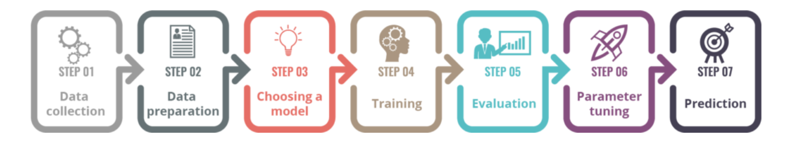
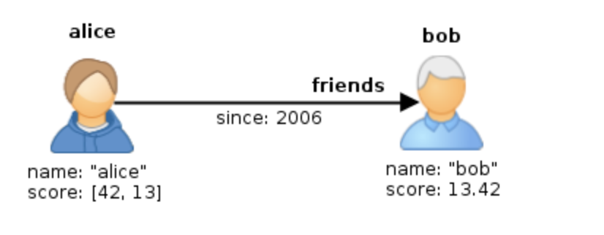
Model Summary
Why we picked our models
Train/Test split of dataset
PCA
Set up model pipeline
Iterate over to find best graph features
Integrate Graph and Baseline features
Run the model (Bootstrapping)
Tabulate results

Slide 20

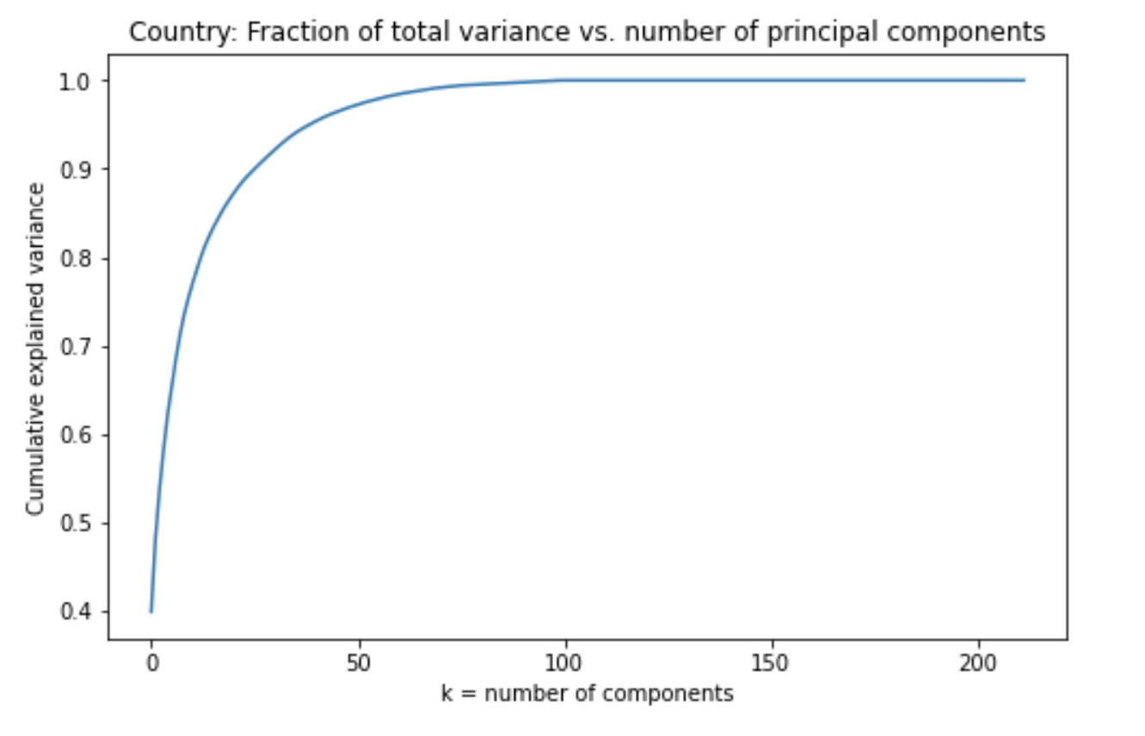
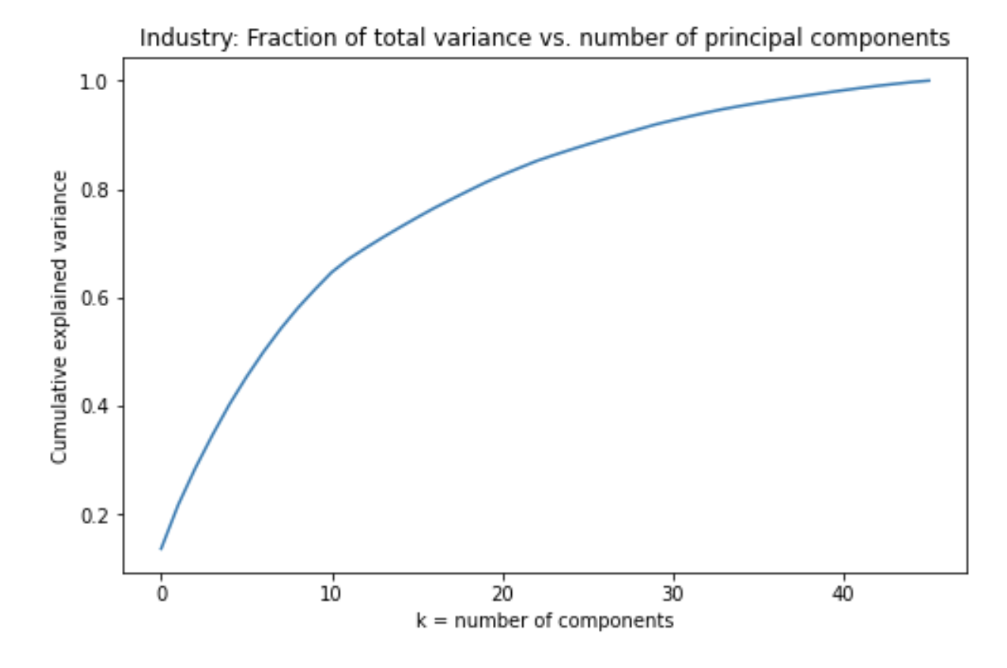
Country (n_components=15)
Industry Features (n_components=10)
PCA

Slide 21
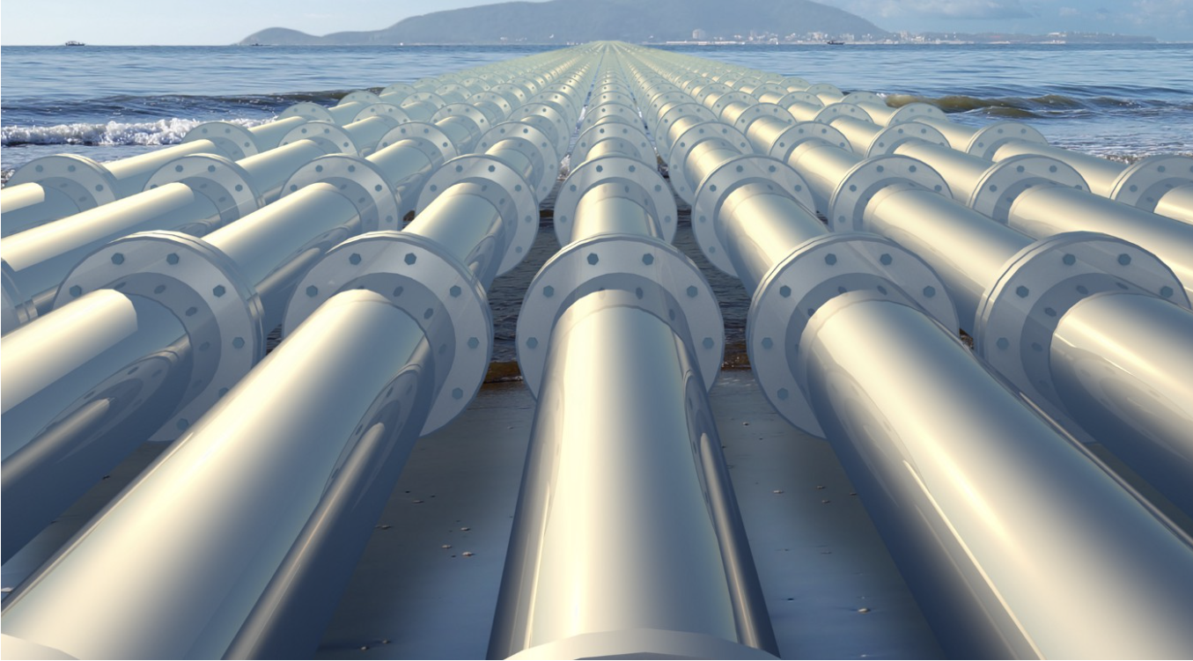
Model Setup: Pipeline
Graph k-core + min shortest path + shortest paths + degrees (in/out) + pagerank
Baseline age + industry + employee count + country + rank + total funding
Baseline-Reduced age + industry + employee count + country
Graph + Baseline-Reduced
Graph + Baseline
Issues & how we solved them
Logistically, sharing data between the team
Modeling, needing to find alternative to GridSearch (RandomizedSearch)
PCA
Using CoLab w/ GPU (Free)

Slide 22
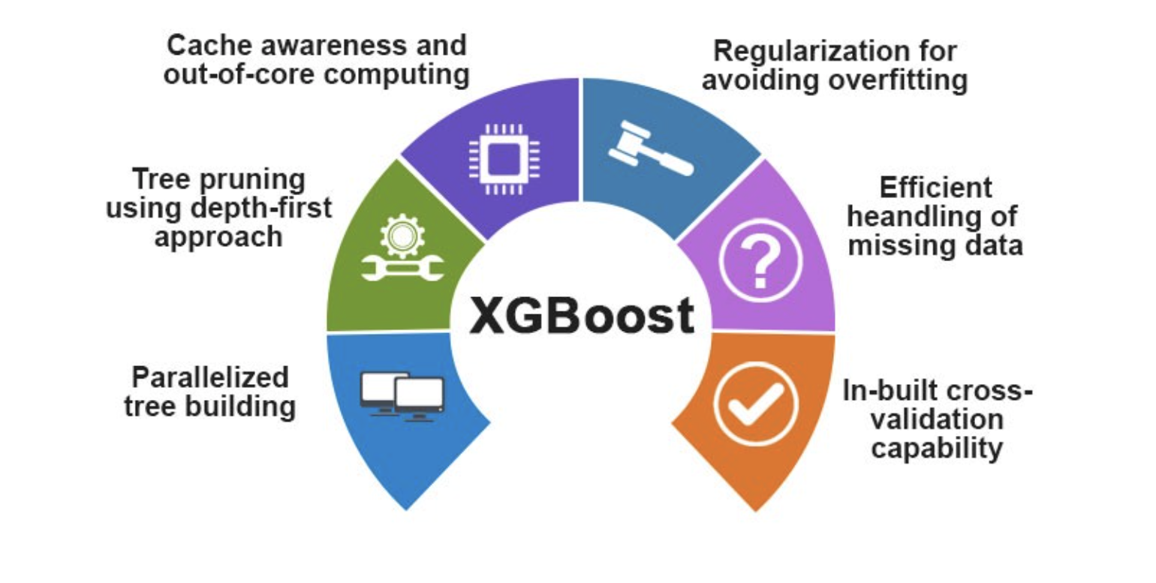
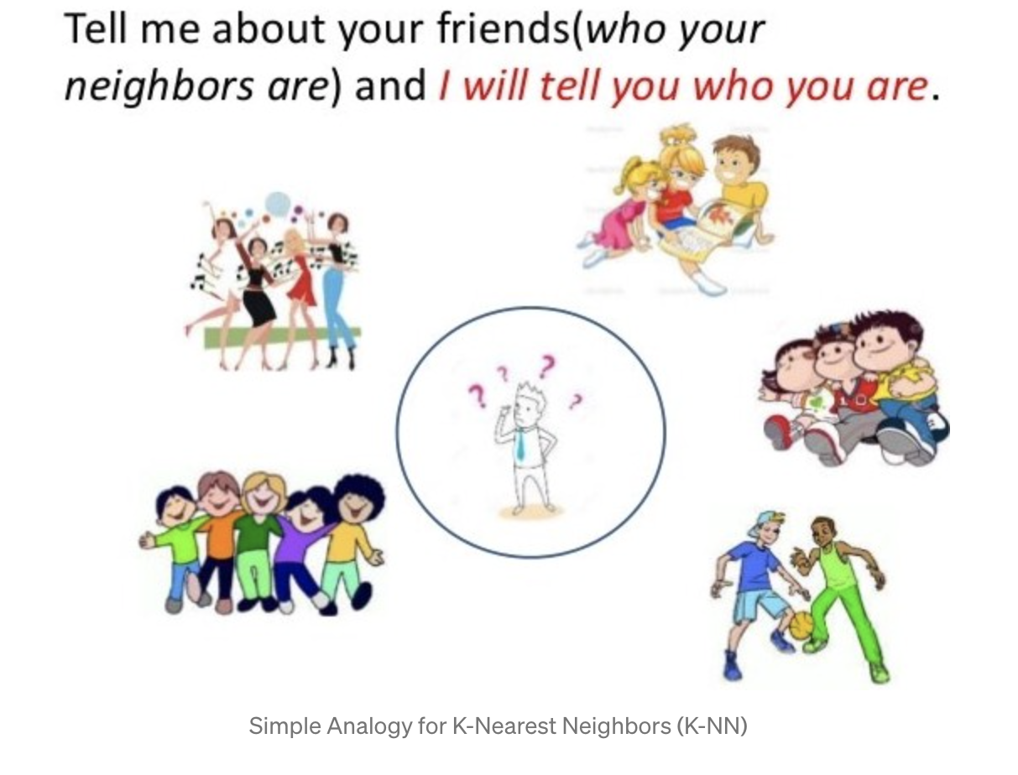
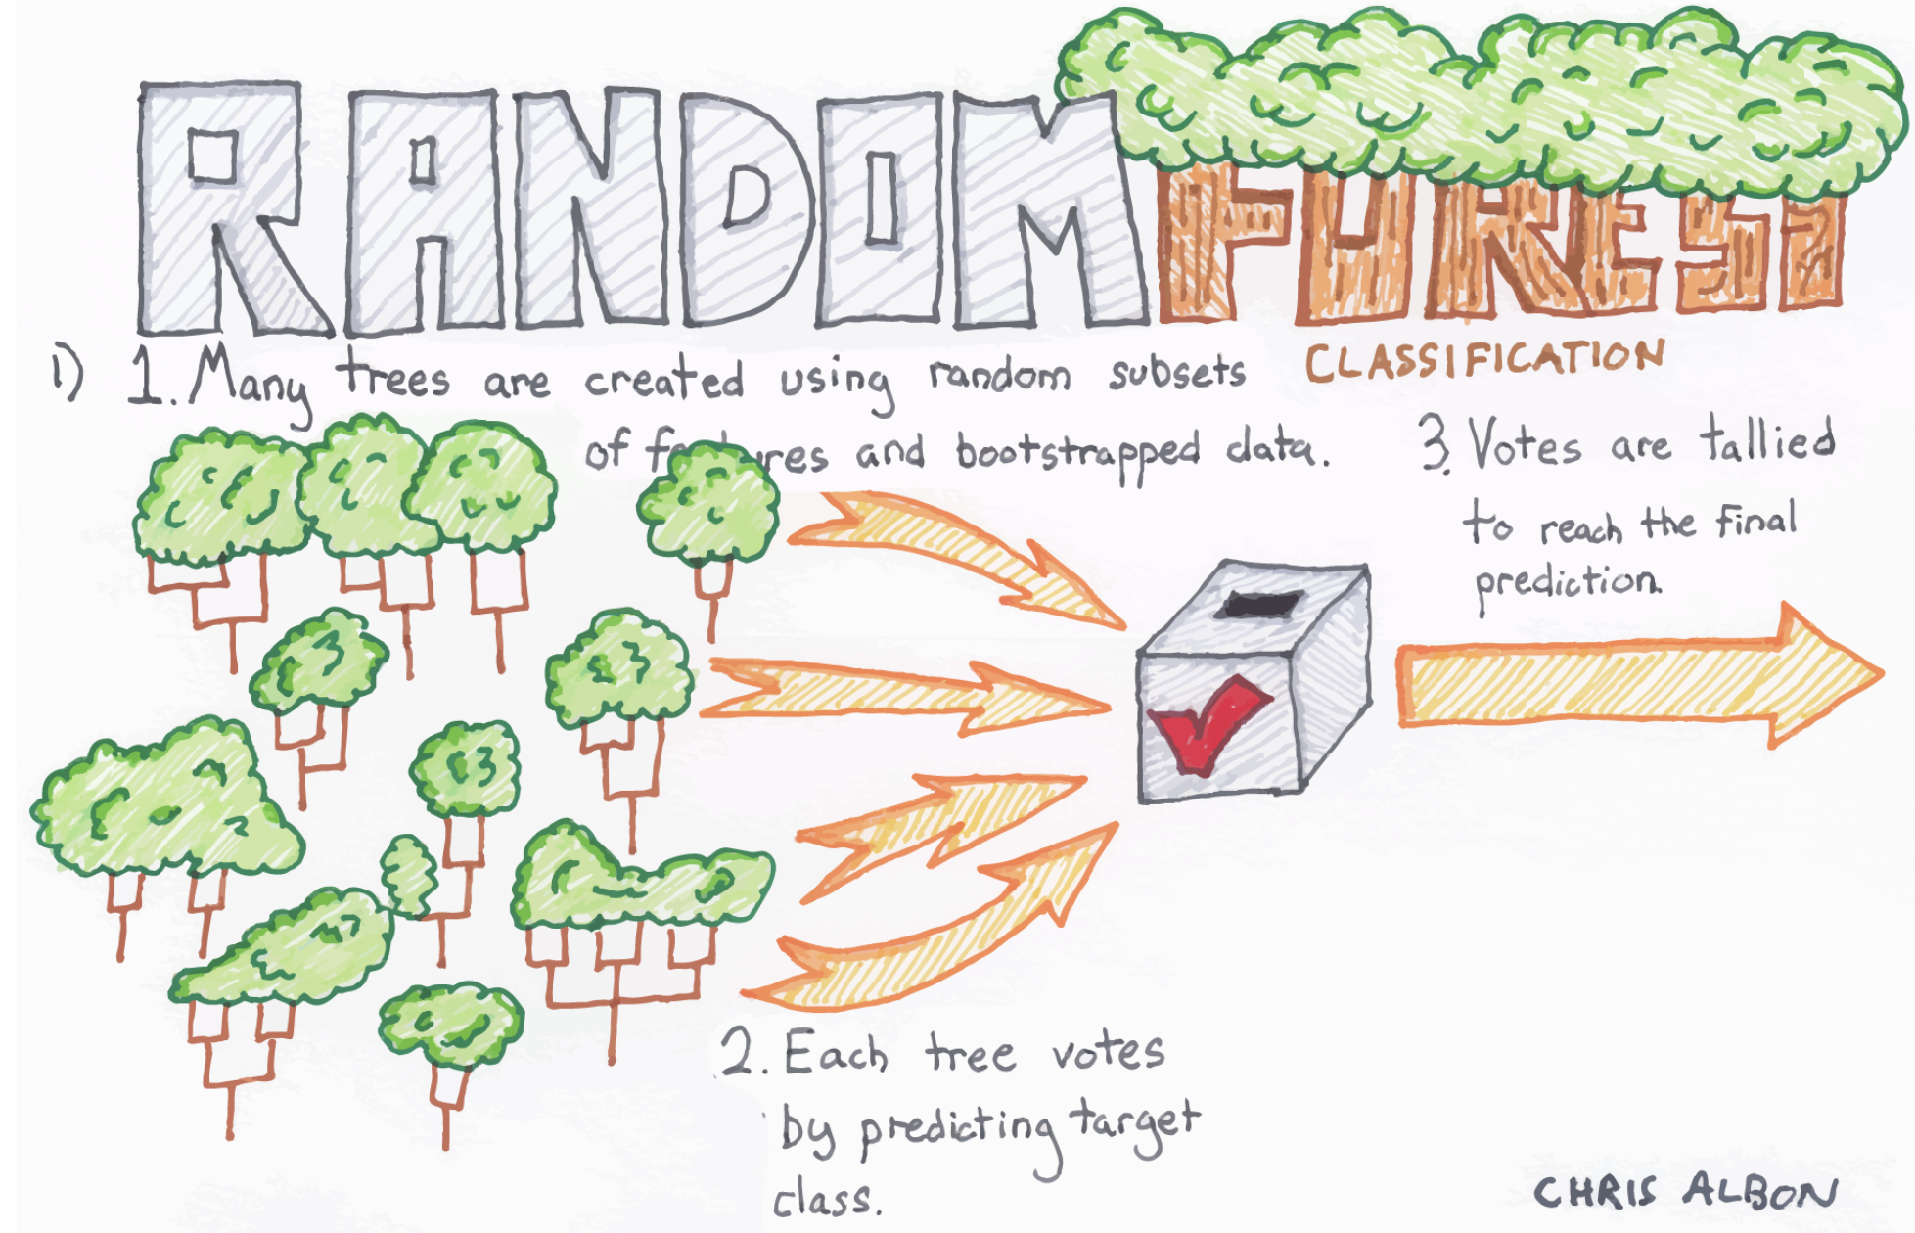
Model Output
Results show our model in different contexts and outputs accuracy score
For LRR, SVM, NB, Decision Trees, Random Forest, XGBOOST
With/without graph features
With/without other feature treatments
With/without expanded graph network

Slide 23
Model Results
Graph: k-core + min shortest path + shortest paths + degrees (in/out) + pagerank
Baseline: age + industry + employee count + country + rank + total funding
Baseline-R: age + industry + employee count + country
DEGREE | TYPE | LRR | KNN | BNB | DCT | XGB | RMF | SVM
4 deg from P1 | Graph | 0.684 | 0.675 | 0.667 | 0.709 | 0.735 | 0.734 | 0.673
 | Baseline-R | 0.710 | 0.702 | 0.612 | 0.762 | 0.767 | 0.800 | 0.751
 | Baseline | 0.710 | 0.713 | 0.596 | 0.775 | 0.877 | 0.820 | 0.724
 | G+Baseline-R | 0.789 | 0.935 | 0.699 | 0.943 | 0.978 | 0.993 | 0.876
 | G+Baseline | 0.794 | 0.957 | 0.715 | 0.972 | 0.994 | 0.996 | 0.899
5 deg from P1 | Graph | 0.690 | 0.688 | 0.675 | 0.714 | 0.726 | 0.734 | 0.687
 | Baseline-R | 0.718 | 0.697 | 0.641 | 0.739 | 0.787 | 0.771 | 0.736
 | Baseline | 0.710 | 0.688 | 0.629 | 0.790 | 0.855 | 0.836 | 0.757
 | G+Baseline-R | 0.803 | 0.935 | 0.743 | 0.941 | 0.985 | 0.996 | 0.878
 | G+Baseline | 0.813 | 0.950 | 0.732 | 0.930 | 0.977 | 0.993 | 0.902

Slide 24
Model Results
Graph: k-core + min shortest path
Baseline: age + industry + employee count + country + rank + total funding
Baseline-R: age + industry
DEGREE | TYPE | ∆LRR | ∆KNN | ∆BNB | ∆DCT | ∆XGB | ∆RMF | ∆SVM
4 deg from P1 | Graph | 0.114 | 0.295 | 0.081 | 0.125 | 0.139 | 0.148 | 0.087
 | Baseline-R | 0.05 | 0.051 | -0.036 | 0.033 | 0.05 | 0.073 | 0.037
 | Baseline | -0.014 | 0.013 | -0.049 | -0.015 | -0.008 | -0.006 | -0.006
 | G+Baseline-R | 0.062 | -0.001 | 0.016 | -0.013 | -0.001 | 0.005 | 0.023
 | G+Baseline | 0.029 | -0.003 | 0.032 | -0.013 | 0.003 | 0 | 0.001
5 deg from P1 | Graph | 0.108 | 0.115 | 0.09 | 0.11 | 0.156 | 0.149 | 0.102
 | Baseline-R | 0.044 | 0.014 | -0.004 | 0.01 | 0.05 | 0.04 | 0.043
 | Baseline | 0 | 0.023 | 0.015 | -0.037 | -0.011 | 0.005 | 0.02
 | G+Baseline-R | 0.038 | -0.005 | 0.037 | 0.069 | 0 | 0.004 | 0.036
 | G+Baseline | 0.015 | 0.003 | 0.057 | 0.027 | 0.004 | 0 | 0.002

Slide 25
References
Pledge 1% Website
Crunchbase Daily CSV Export
Investors Are Social Animals: Predicting Investor Behavior using Social
About Link Weightings
Network Features via Supervised Learning Approach
Our github repo
rapidsai/cugraph: cuGraph - RAPIDS Graph Analytics Library
apple/turicreate: Turi Create simplifies the development of custom machine learning models.
Software for Complex Networks — NetworkX 2.5 documentation

Slide 26
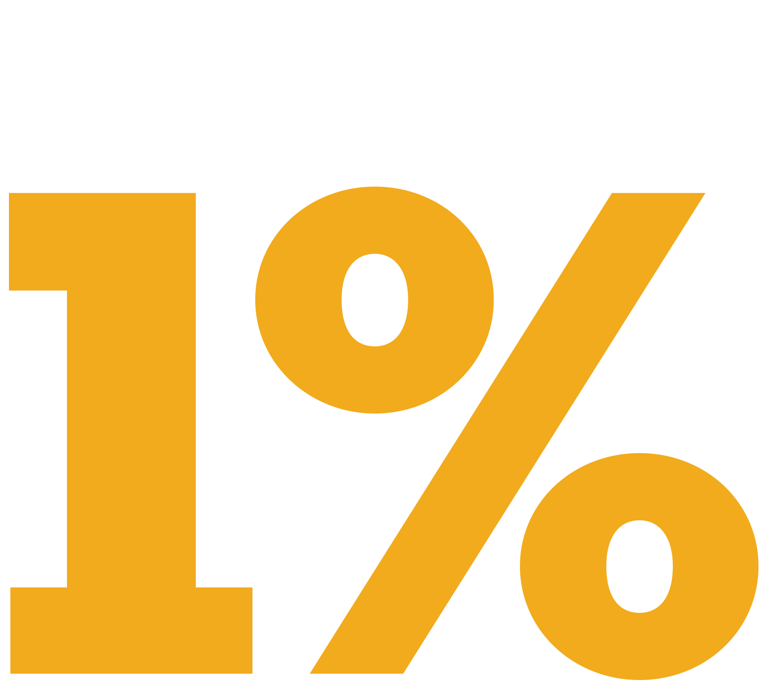
Network Analysis of with Crunchbase
Project Team: Aditya Mengani, Ognjen Sosa, Sanjay Elangovan, Song Park, Sophia Skowronski

Slide 27
Summary of Challenges & Our Approach
SS NOTE -- I got the challenges for other sections, you should articulate how these were challenging during modeling :)
Computational issues
Reduce_mem_usage
We need a bigger computer!!!

Slide 28
Graph EDA: connected components
https://www.ibm.com/support/knowledgecenter/SSJSV9_9.2.1/com.ibm.i2.anb.doc/about_k_core.html

Slide 29

Investment behavior as a link prediction problem
Predict the changes of edges or nodes of social networks over time
Assumptions
Trust and social influence affects the stability of investment markets
Investors invest in companies based on social relationships, be it positive or negative, similar or dissimilar
What the researchers found
The greater the similarity, the more investment activities were found
The greater the number of common neighbors, the less likely that investors will invest in companies
Notes:
(AKA our backup plan, time series that we may explore later)
Sophia:
Social influence can be measured as a link prediction problem from Crunchbase, which predicts changes of edges or nodes of social networks.
They found that more similar organizations get the same type of investment activities, but there was a competitive aspect to it that impacted organizations that shared common neighbors .
Used Decision Trees, SVM, and Naive Bayes modeling to make predictions whether a company would receive an investment or not.
All models performed above baseline of 0.6. Total peripheral resistance (TPR) ranged between 56-91% and Area under curve (AUC) ranged between 0.63-0.8
FROM ARTICLE:
Link prediction has been applied to datasets in popular social networks, which includes Twitter, Facebook and others. These studies include the prediction of positive and negative links to recommending friends on Facebook to using computationally efficient topological feature.
SVM and Decision Trees performed above baseline levels in general, while Naïve Bayes failed to meet the baseline performance for AUC and TPR.
The results for SVM and Decision Trees are generally encouraging: on an aggregate level, both learning algorithms produced an AUC of over 0.77and TPR of over 60%.
In addition to aggregate performance, the strategy also performed well in terms of individual industry categories: most industries across all three learning algorithms performed above the baseline performance of 60% and 0.6 respectively, with most TPRs ranging from 56% to 91% and AUC ranging from 0.63 to 0.80

Slide 30
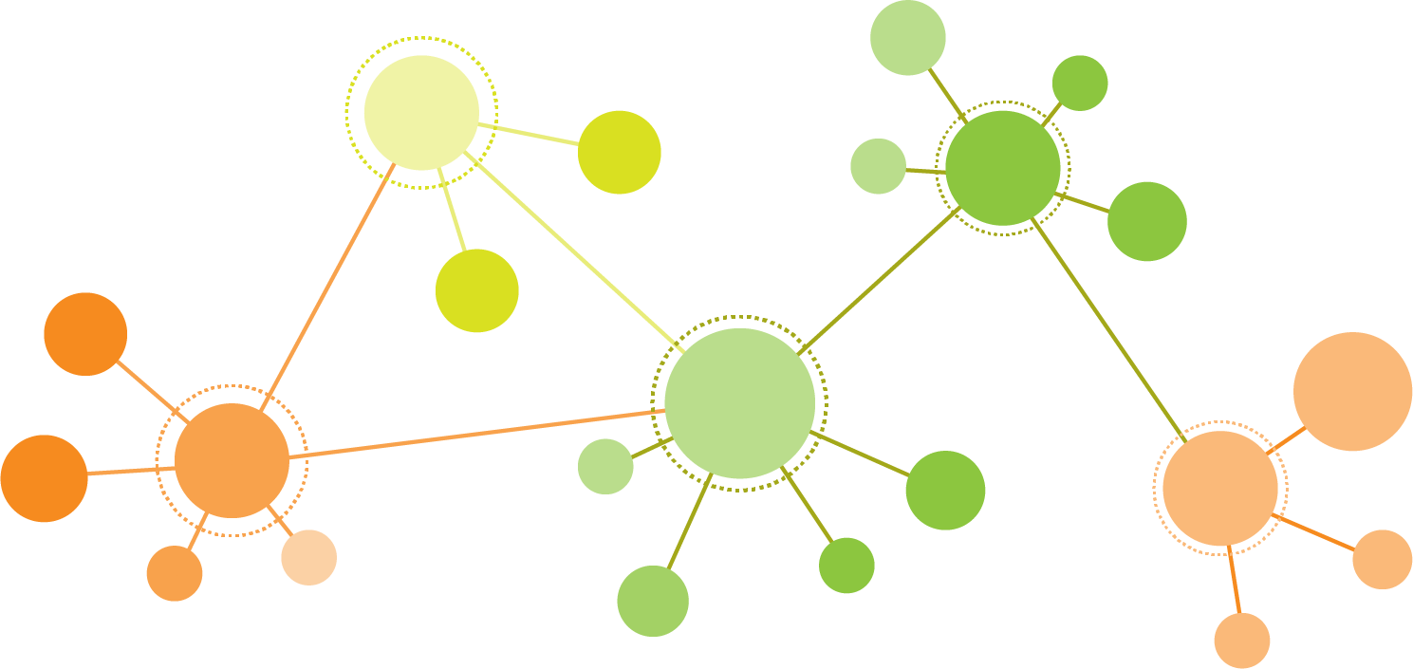
Corporate social impact as a link prediction problem
Use network analysis to predict whether or not a company is in the P1 network
Companies are more likely to "take the pledge" if they have stronger relationships in terms of proximity through investment and/or job affiliations.
Represented as a directed graph
Nodes: Organizations (Companies, Investors), People
Edges: Partner Investments (Person → Company), Investments (Company → Company), Jobs (Person → Company)
Notes:
Sophia:
The comparison to Pledge 1% here is that we believe corporate social impact and tech philanthropy can also be modeled through business relationships and existing social networks, like investment behavior.
At P1, new membership usually comes in through existing relationships, such as a CEO/Founder heard about us from their investor or startup accelerator that are also Pledge members.
Similarly to the research paper, we hope to leverage graph data structures and Crunchbase business relationships to predict whether or not a company is part of the Pledge 1% network.
Hypothesize that companies are more likely to "take the pledge" if they have stronger relationships in terms of proximity through investment and/or job affiliations. Who knows who, etc.
Now I’ll hand it off to Song to share an overview of the data!

Slide 31
Crunchbase Data
1 million+ organizations
Company information (e.g. domain, employee count), leadership & board members, investments and funding, etc.
Data sourced mainly through venture partners
Other sources: AI and machine learning, community of contributors, 3rd party partnerships
Access through Rest API or a daily CSV export
Notes:
Song:
First, to give an overview of Crunchbase data in general -
Crunchbase data contains information on over 1 million organizations
There’s a ton of data available on these companies, including company info (such as domain and employee count), key leadership & board members, investments and funding
Most of the data is collected through Crunchbase’s venture partner program, where companies provide data to Crunchbase on a regular basis in return for access to crunchbase’s database
Data is also collected through AI and machine learning algorithms, a large community of contributors,and third party partnerships
Crunchbase data can be accessed through an API or a daily CSV export

Slide 32
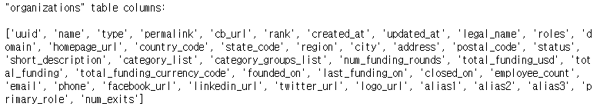
Dataset Overview
P1 Organizations
Crunchbase CSV export (09.08.2020)
18 files
Focus on: organizations, jobs, investments, partner Investments, funding rounds
Size of the P1 network (as of 09.08.2020):
7,822 P1 organizations in Crunchbase
~3.9K investors and 1.5K partner investors associated (~15.1K total investments)
~9K executives, 1.3K board members, and 1K board advisors associated
Notes:
Song:
For our project, we are using data from a given point in time
So, a list of P1 organizations and the date the company became a P1 company
And the Crunchbase CSV export from September 8th
The CSV export contains 18 files total
We haven’t finalized what data we will ultimately include in our model, but we will probably focus on data from organizations, jobs, investments, partner investments, and funding rounds (screenshot of columns in “organizations” below to give a feel)
As mentioned in the previous slide Crunchbase data includes information on over 1 million companies in total
However, there are 7,822 P1 organizations, and when we ran some simple merges we saw that there are about 3.9K investors and 1.5K partner investors associated with P1 companies
And about 9K executives and 1.3K board members associated
Next, we’ll go over some of the initial EDA

Slide 33
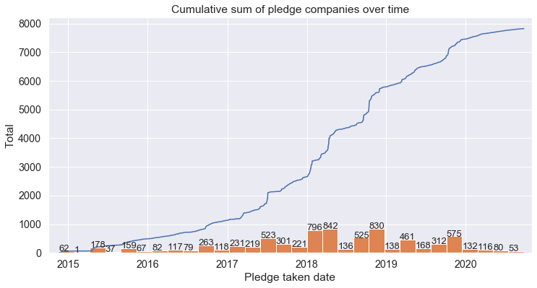
EDA: Pledge 1% Growth Trends
Notes:
Can think about growth as increase in pledges...

Slide 34
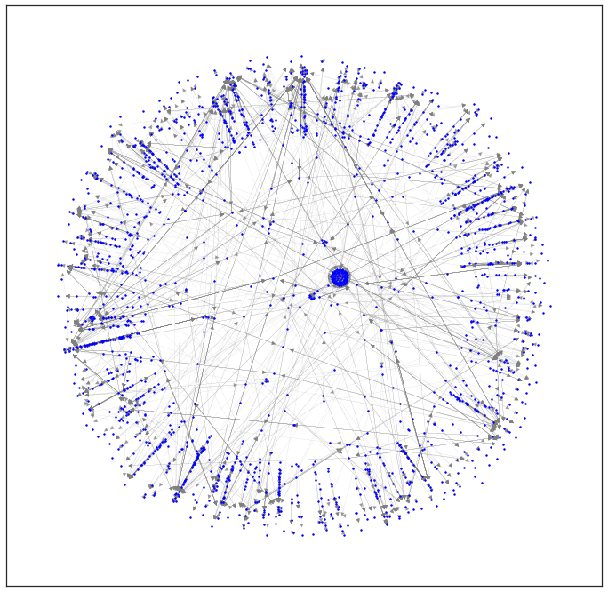
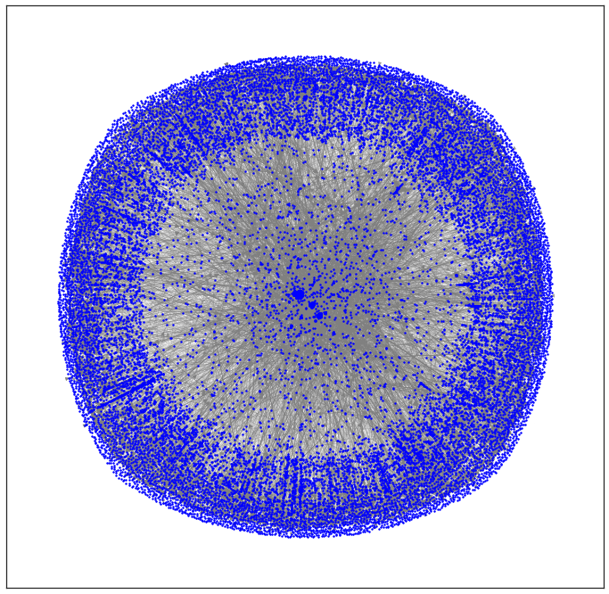
Pledge 1% Growth between 2015 and 2020
Notes:
Or increase in relationships!

Slide 35
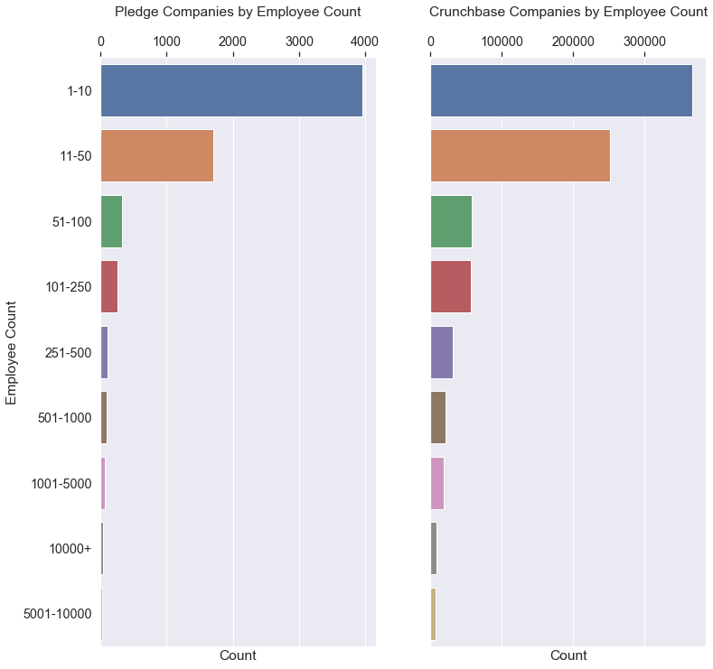
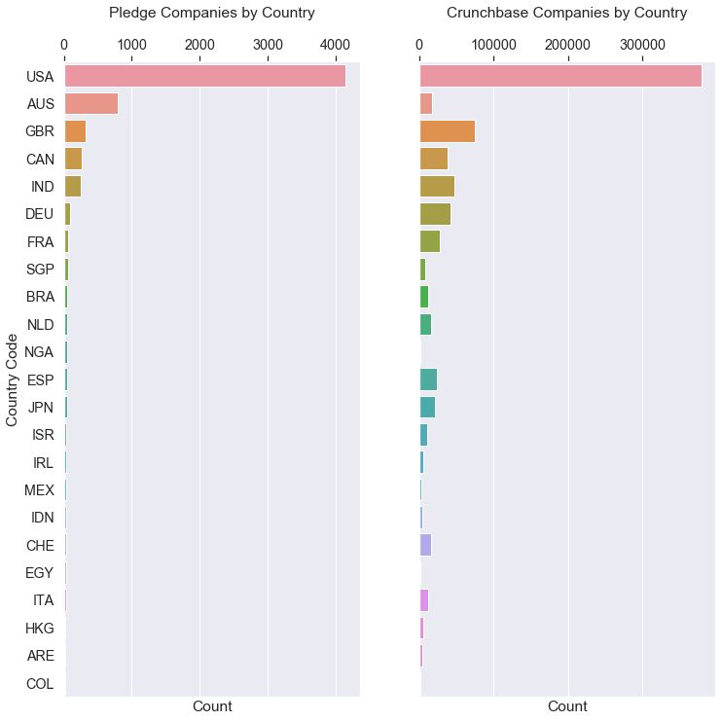
EDA: Pledge 1% Companies Key Insights
… are predominantly US based and ...
When compared to Crunchbase, Pledge companies tend to have smaller number of employees ...
… are more heavily comprised of tech co’s.
Notes:
Pledge companies tend to have smaller number of employees, are predominantly US based and are heavily comprised of tech companies.

Slide 36
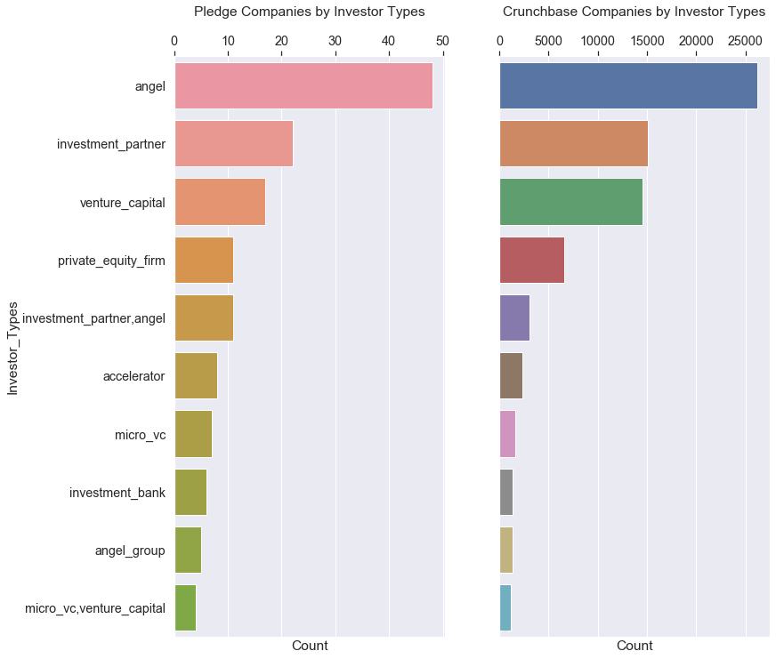
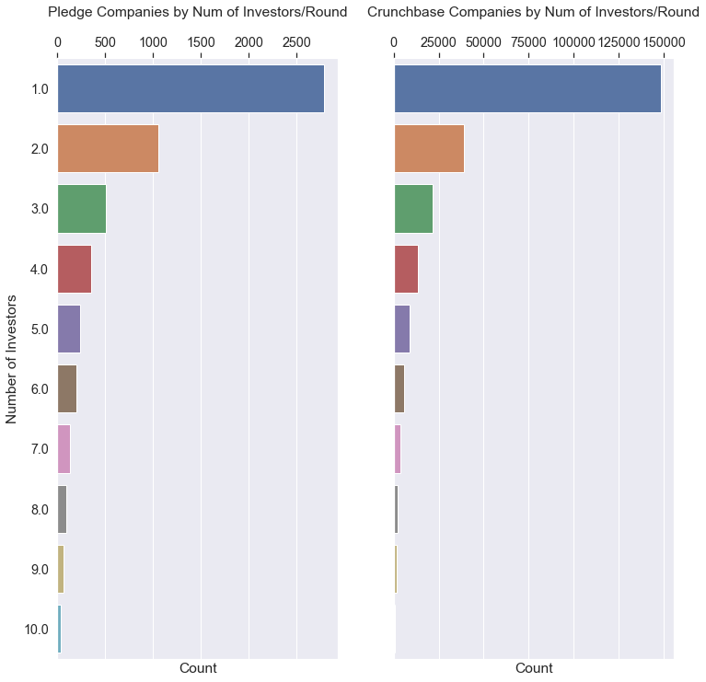
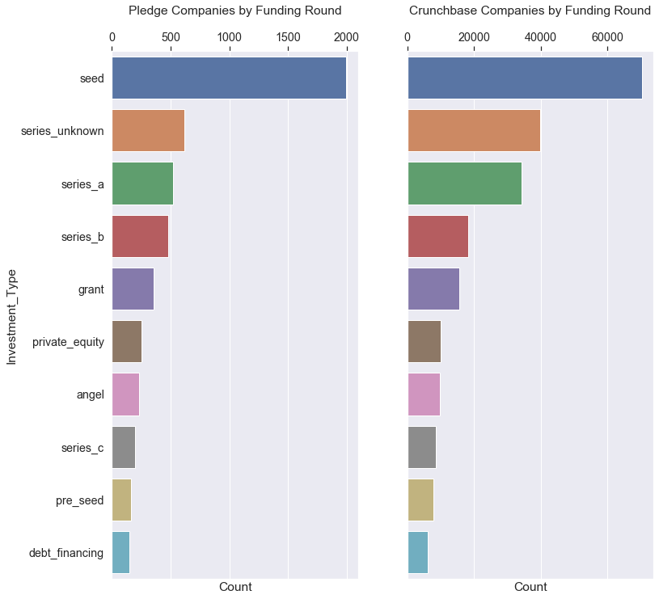
EDA: Capital Raising Key Insights
... that step in early in seed rounds ...
... with a larger # of investors participating.
When compared to Crunchbase, Pledge companies tend to source capital from angel investors ...
Notes:
As compared to CB, P1 most common investors are angel investors that step in early during seed round with larger number of investors participating.

Slide 37
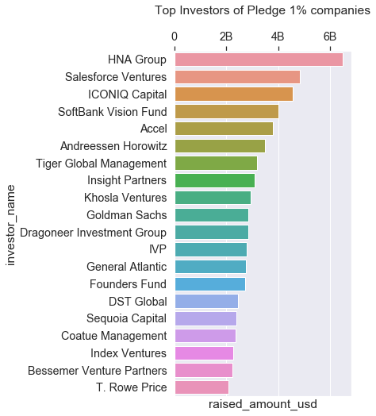
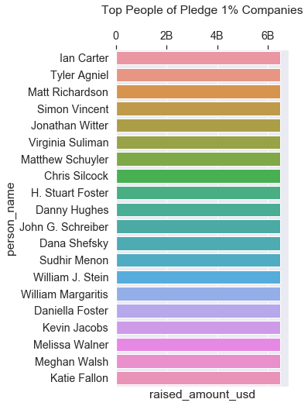
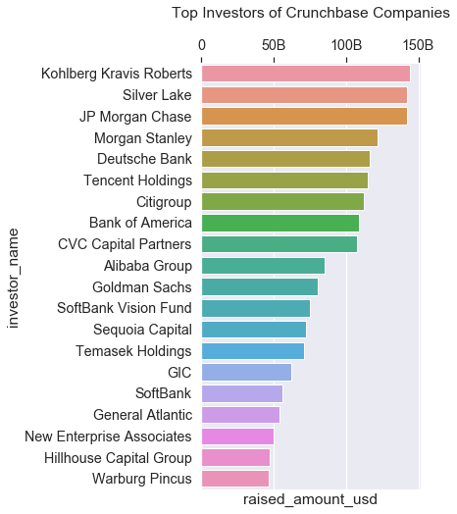
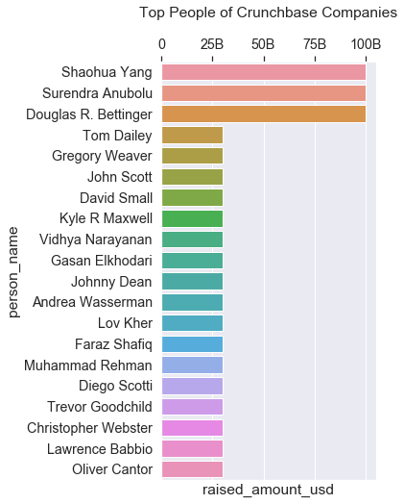
EDA: Investor & People Key Insights
There is no overlap between top investors and top people among Pledge and Crunchbase companies.

Slide 38
EDA: Key Insights
Missing data from Crunchbase:
Financial information > 80%,
Employee count > 27%
TBD:
Jobs
Education
IPOs

Slide 39
Basic Model (No Graph Features)
Binary classification problem based on
Employee count, Region, Industry, Rank
Num observations : 12134 Num dimensions : 270
Feature engineering
Rank
Industry, employee count, role → dummy columns (Ordinal values)
Feature set for each industry category/Country code/Employee count

Slide 40
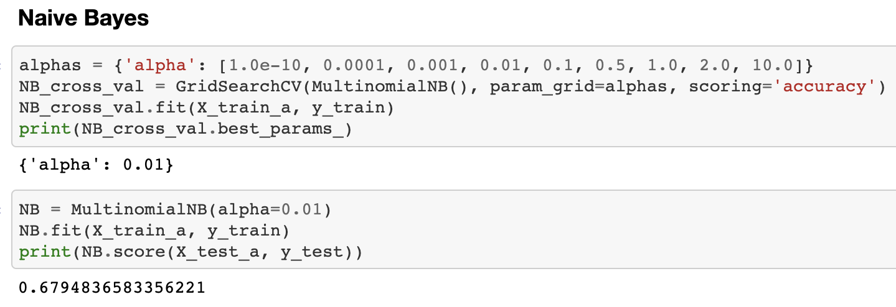
Basic Model (No Graph Features)
Results(Averaged scores from random sampling of data in 100 iterations):
Ordinary Least Squares (OLS) : Adjusted R-squared 0.28 (Strong multicollinearity)
Linear Regression : 0.26
K-Nearest Neighbour : Accuracy score 0.62
Logistic Regression : Accuracy score 0.50
Naive Bayes : Accuray score 0.68 (Highest)

Slide 41
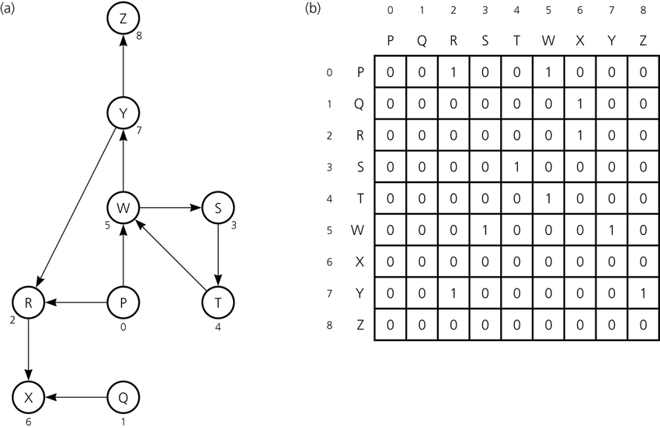
Next Steps
Create an Adjacency Matrix
Figure out which models to try: - Decision Tree based on CART Algorithm - SVM (Support Vector Model) - Naive Bayes
Features to incorporate - Translating graph features to model features - Dealing with missing data
Notes:
Our immediate next step is to create an adjacency matrix. We’ll cover this in week 12, but basically the matrix shows how the nodes within the graph are linked to one another. A simple example is shown on the screen.
From there we’ll need to start thinking about what kind of model we should use. A Decision Tree is an easy to understand model, and is easy to visualize. The other two types of models listed are widely accepted models that could explain the data well.
While working on the models, we’ll also need to consider which features to incorporate. There are many features of graphs that we could put in the models, like like the degree of each node, the density of the graph, or measures of centrality
We’ll also need to consider the missing data: Should we ignore it or impute it?

Slide 42



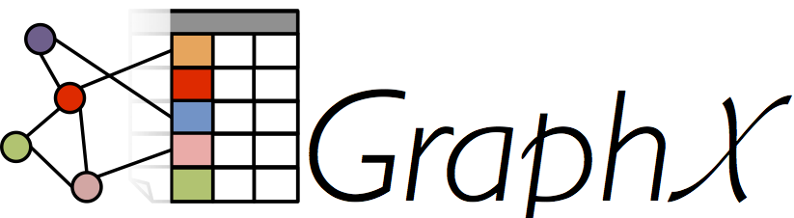


Next Steps and Challenges
Incorporating Time
Don’t necessarily need to use time series data
Incorporate time as a feature
Graph Tools
Network Metrics
Database Tools
Notes:
One of the parts we were worried about with this project is the incorporation of time-series data. In order to have time-series with a network, we’d have to connect forward all our data and add several datapoints for each node. This would have made the network very complex especially at the scale of the Crunchbase dataset.
Luckily, Amit helped us figure out that we don’t actually have a time-series question. Really, we’re trying to predict who’s a good candidate - Some features will go up or down over time, but how long someone waits to invest isn’t too relevant. We could, however, include time as a feature or normalize time. For example, we could create a feature that is the amount of time between when an event occurs and when they commit to Pledge 1%.
There are several graph tools that we’re considering using, which are listed on the screen. Amit has told us that he’d be willing to help us figure out which to use.

Slide 43
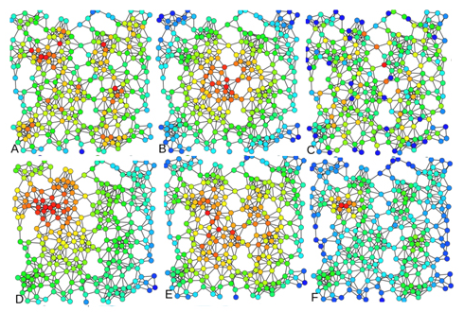

Node Level Properties
Degree centrality: incident edges, reveals activity
Closeness centrality: centrally located for access to other nodes, reveals ability to access
Betweenness centrality: power brokers connecting a lot of other nodes, reveals control over flow in network
Eigenvector centrality: where the core of the network is
Katz centrality
Alpha centrality
PageRank

Slide 44
Graph Level Properties
Degree distribution: is there a power law structure?
Giant component
Shortest path: shortest sequence of links connecting two nodes
Diameter: maximal distance
Density: undirected/directed

Slide 45
Possible applications
Identify advocates of Pledge 1%, help show giving back is “good for business”
From the investment angle, this work can help startups identify prospective funders

